Slide 1
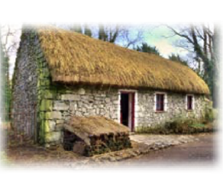
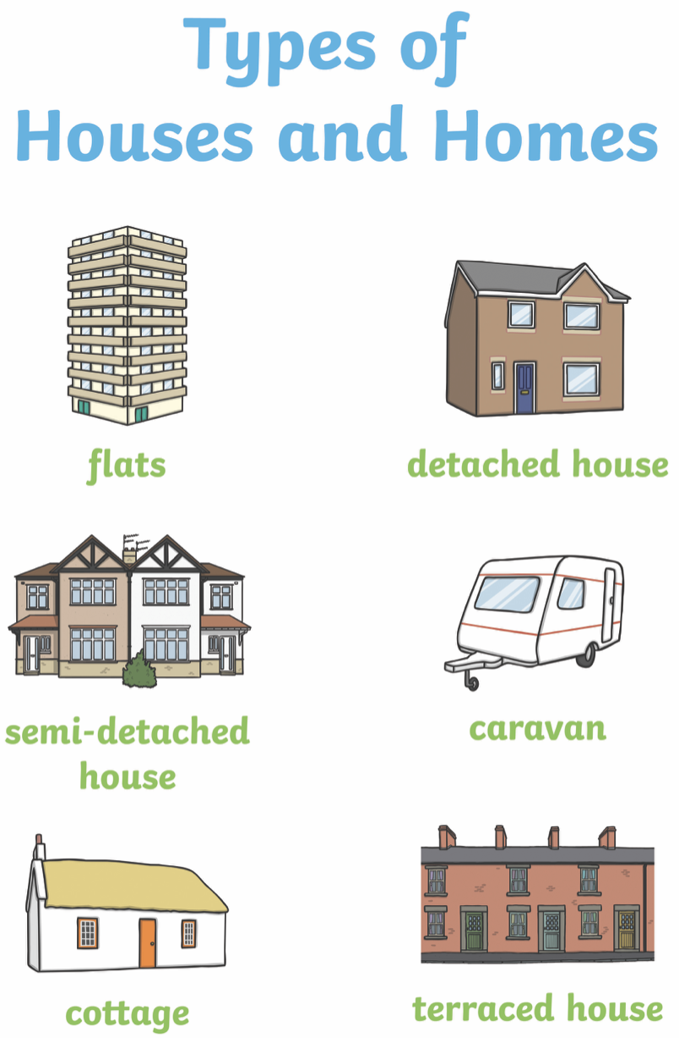
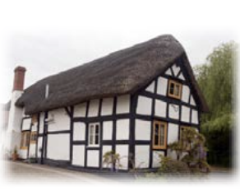
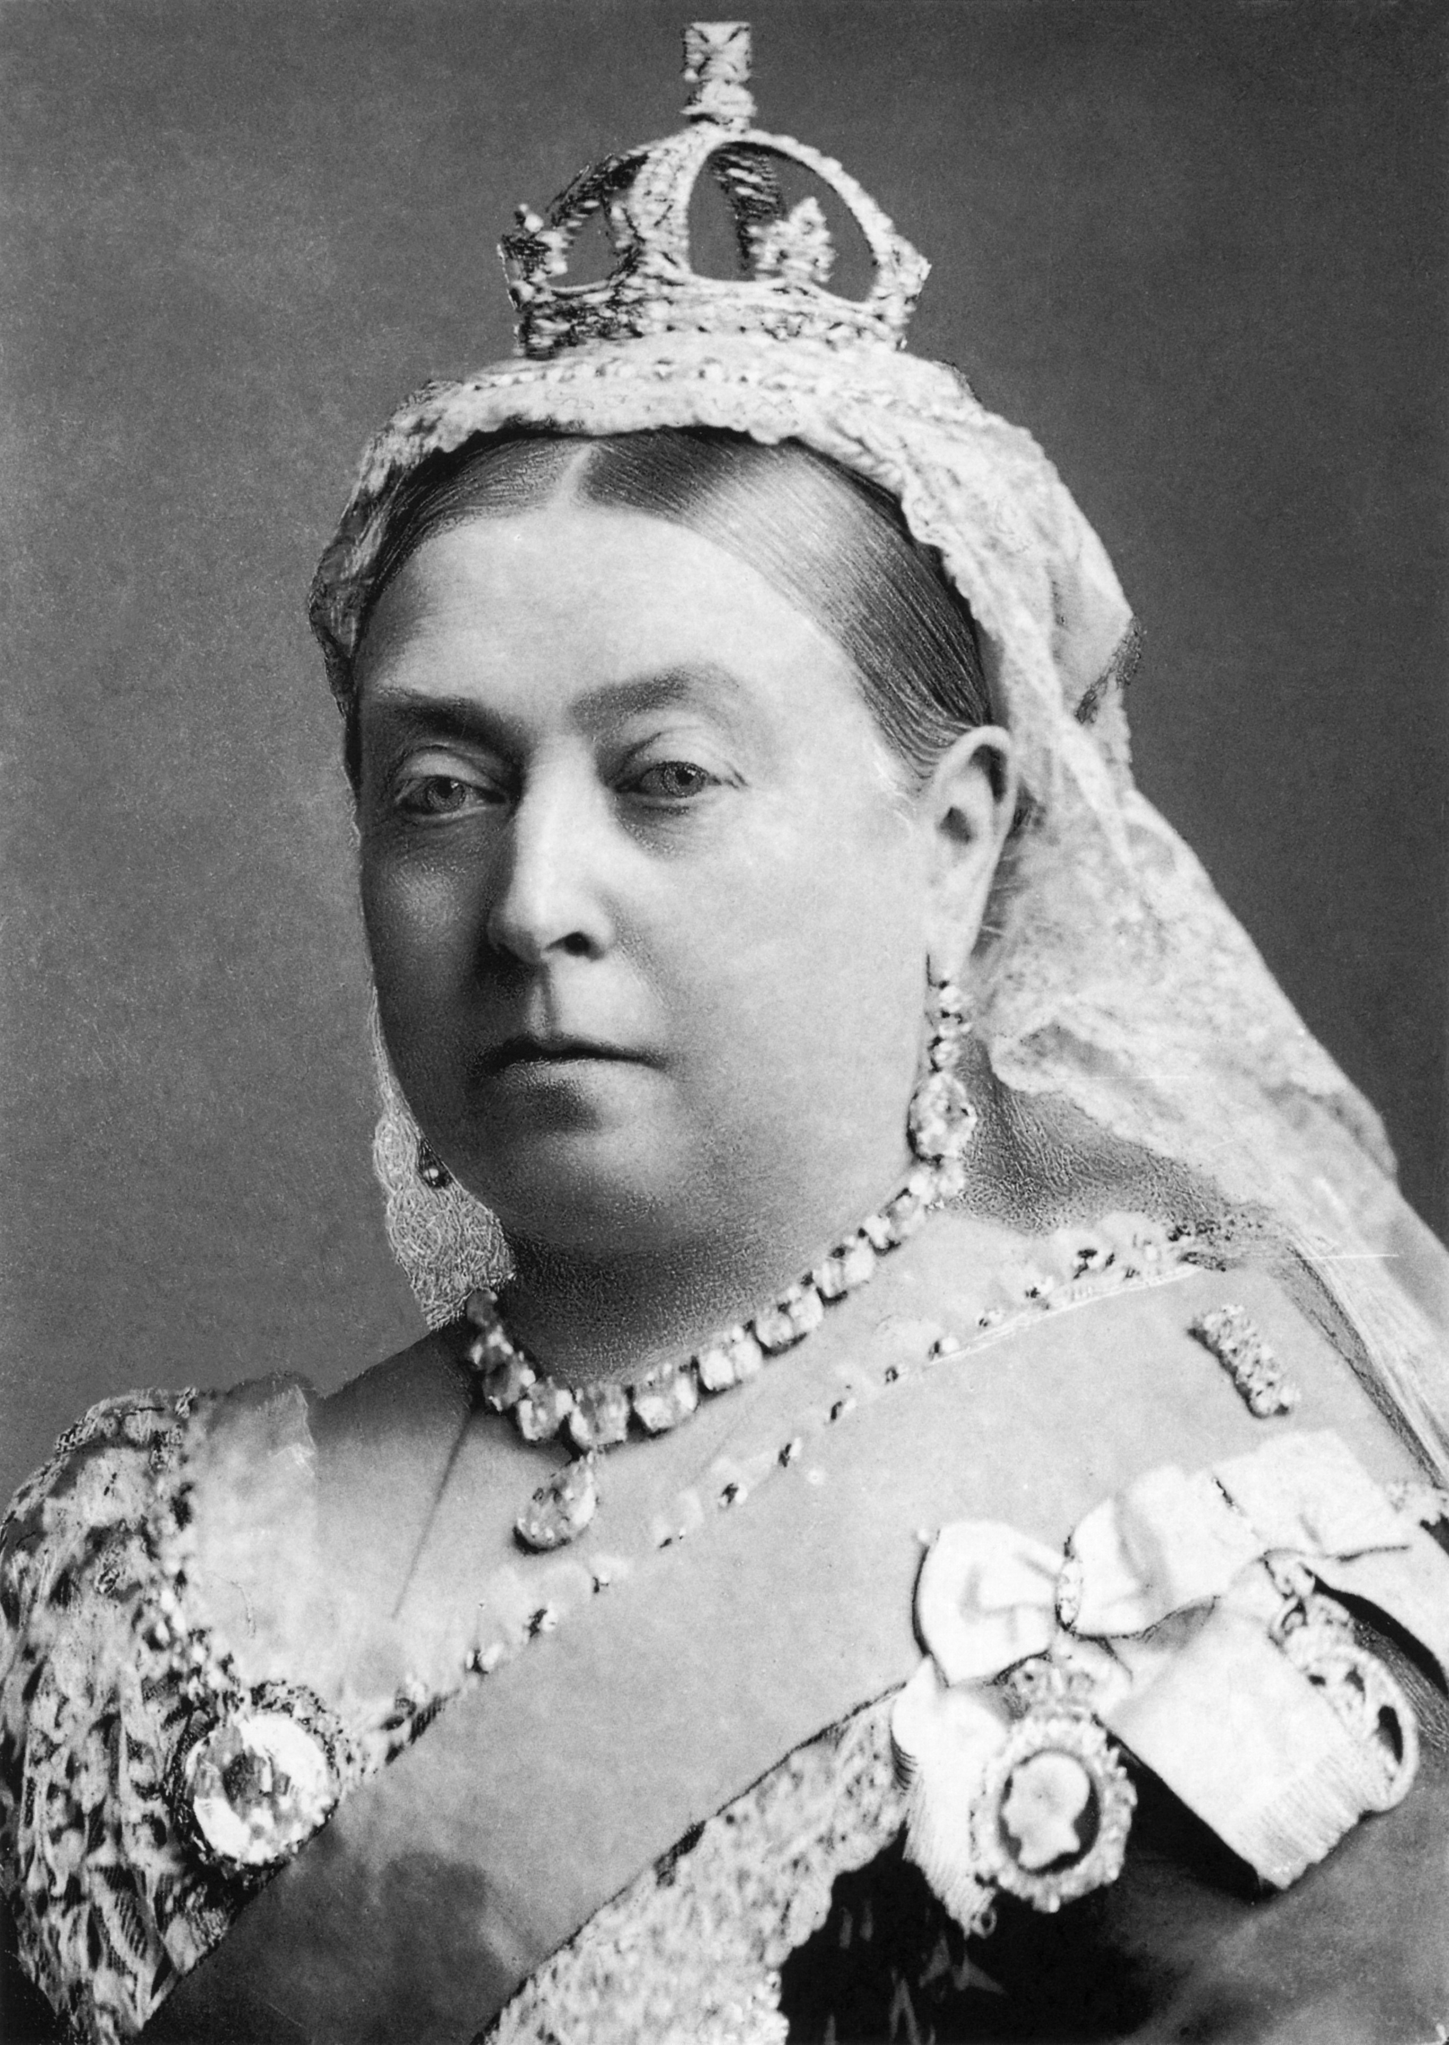
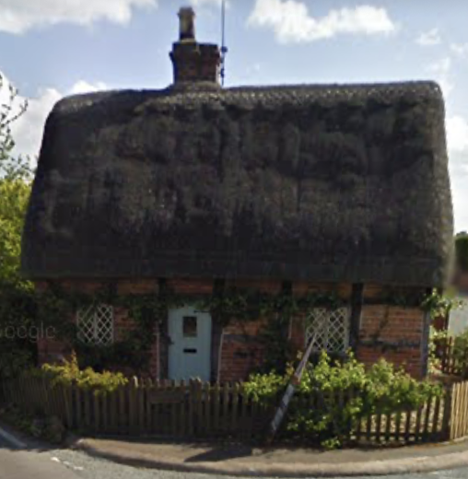
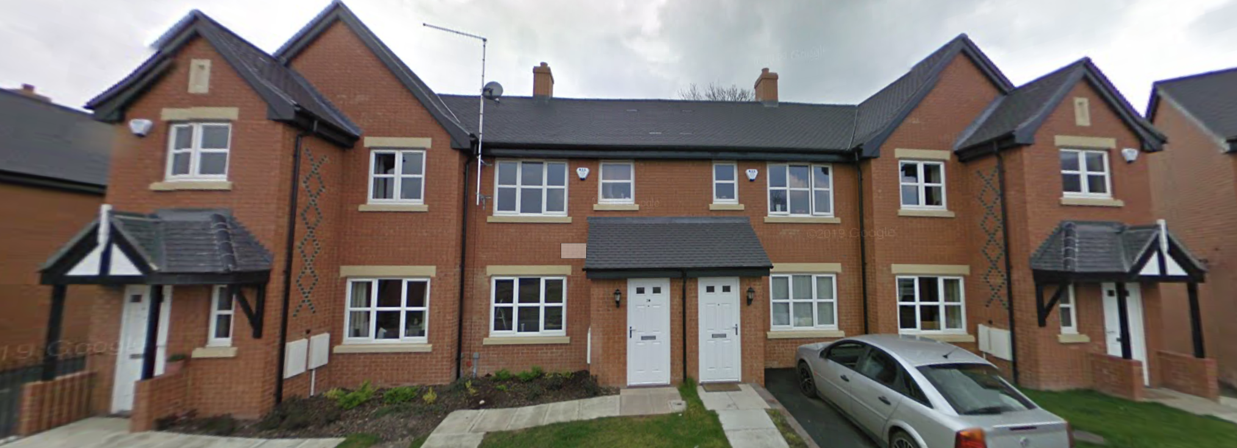
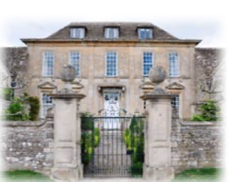
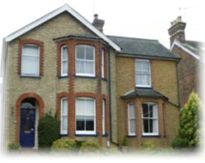
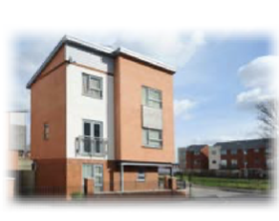
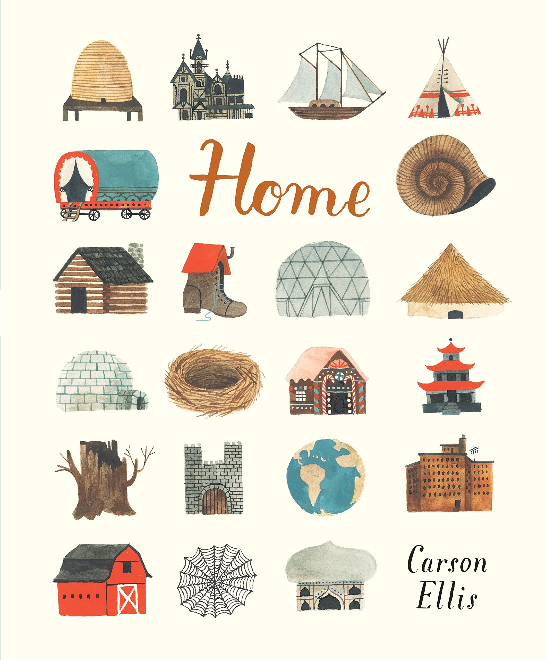
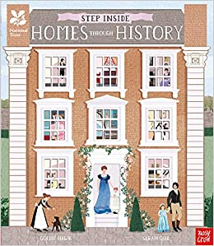
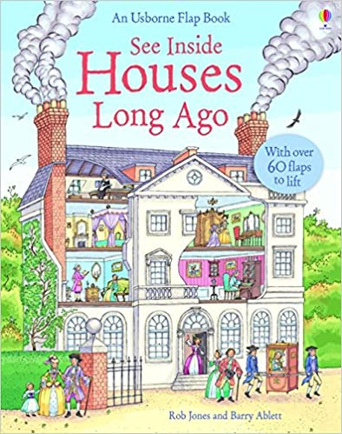
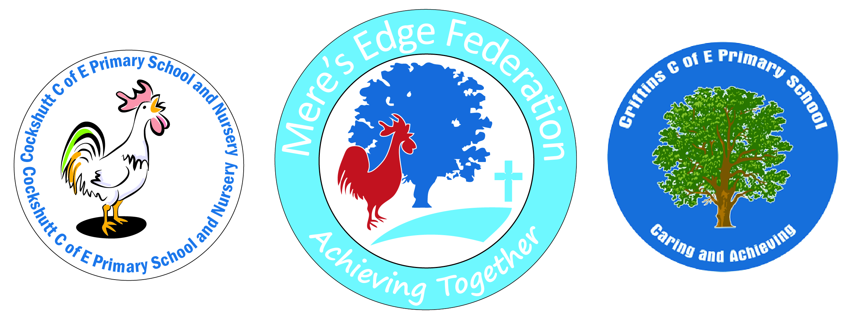
YEAR 1 – Homes Through History – Knowledge Map
Subject Specific Vocabulary
Modern | New or recent.
Detached house | A house that stands alone and is not joined to another house.
Semi-detached house | A house that is joined to another house on one side.
Terraced house | A house in a row of three or more houses joined together.
Bungalow | A house that is all on one level and has no stairs.
Flat | A one-floor home in a large building (with other flats).
Caravan | A large van that be lived in. It can be moved around easily from place to place.
Houseboat | A small boat on a river or canal which people live in.
Tudor | A time when the Tudor family were the kings and queens of England.
Georgian | A time when four kings called George were the kings of England.
Victorian | A time when Queen Victoria was queen of England.
Dolly | Used to move and spin the washing around in the boiling water of a washing tub.
Mangle | Used to squeeze water out of wet clothes.
Washboard | A board used to scrub washing to make it clean.
Range | A Victorian cooker. All of the cooking was done on a range.
Significant People & Local Heritage
Queen Victoria
Local old, detached house
Local, modern houses
Five Sticky Facts
People live in many different types of homes; some of these are called detached, semi-detached, terraced, bungalows and flats.
Houses from different times in history were built using different materials and different building styles.
Place homes from the 5 key time periods in chronological order: Medieval, Tudor, Georgian, Victorian, Modern.
Most Victorian homes didn’t have electricity so were very different to modern homes. They didn’t have TVs, washing machines or electric lights.
Queen Victoria reigned from 1837-1901 and this time was called “The Victorian Period”.
Exciting Reads

